Slide 1





Problem Theme 2
LARANA, INC.
Create a ChatBot
BUSINESS
Team 2
PROJECT
WWW.REALLYGREATSITE.COM
Repository :https://github.com/Mastercard-Code-For-Change/Team-2

Slide 2

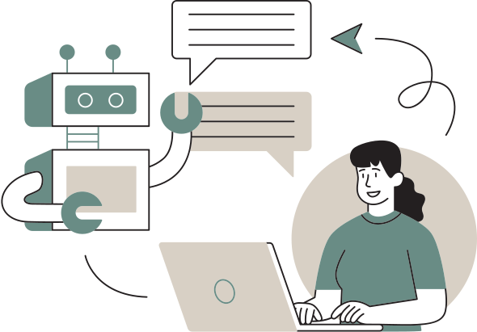

PROBLEM STATEMENT
Katalyst India, an NGO supporting over 1200 students and 900 mentors, recently launched their first mobile app as part of their digitalization efforts. While this app has been a step forward, it has also brought a new challenge. The NGO receives a high volume of similar questions from their users every day.
PROBLEMS :
Repetitive Queries: same questions
Efficiency Loss: Reduces focus on more critical tasks and overall productivity.
User Frustration: Delays in response time

Slide 3


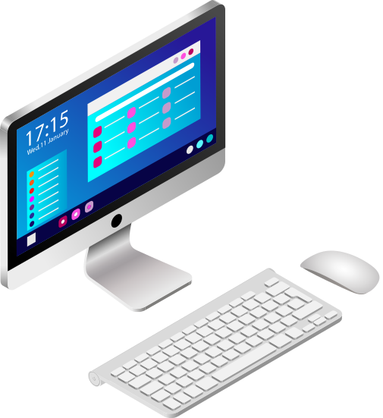


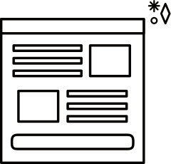




ARCHITECTURE
Desktop view
admin page
Database
Desktop
SignIn Module
Mobile view
Landing page
Mobile
Query
Tablet view
PULL
Katalyst
Website
Tablet
SocioBot
PUSH

Slide 4
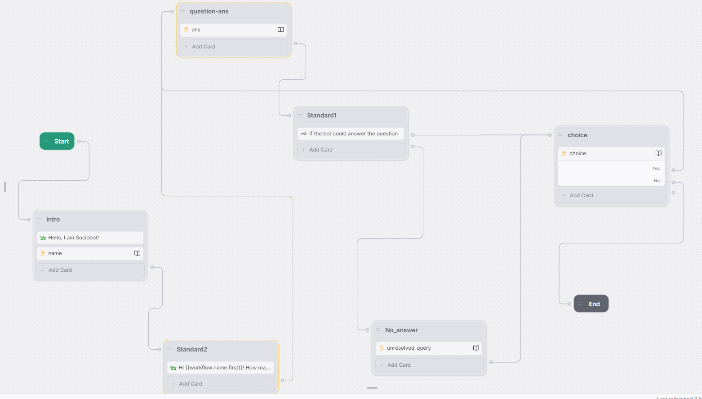

Slide 5
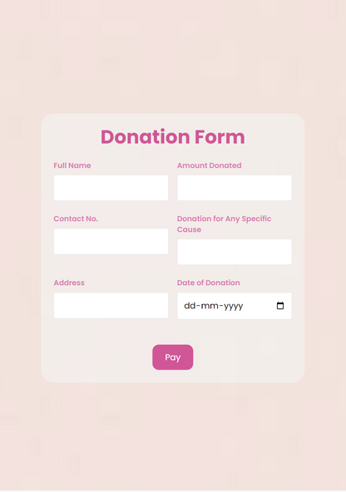
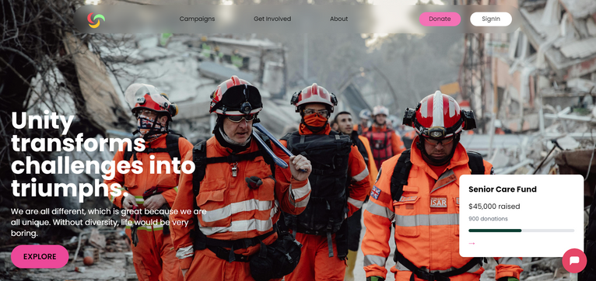
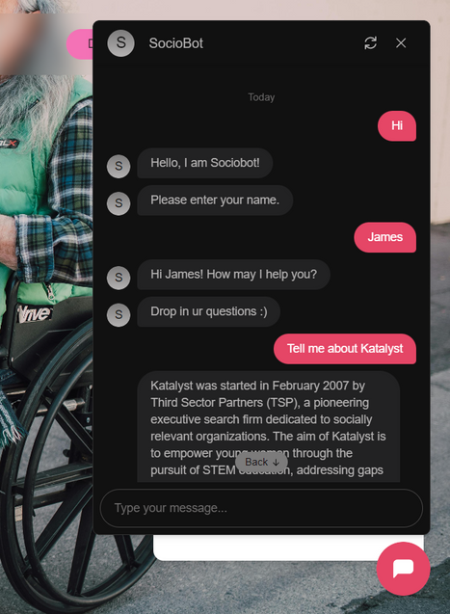
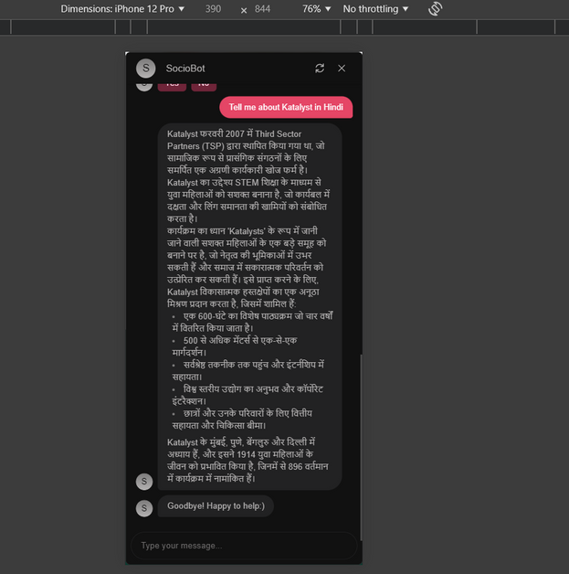
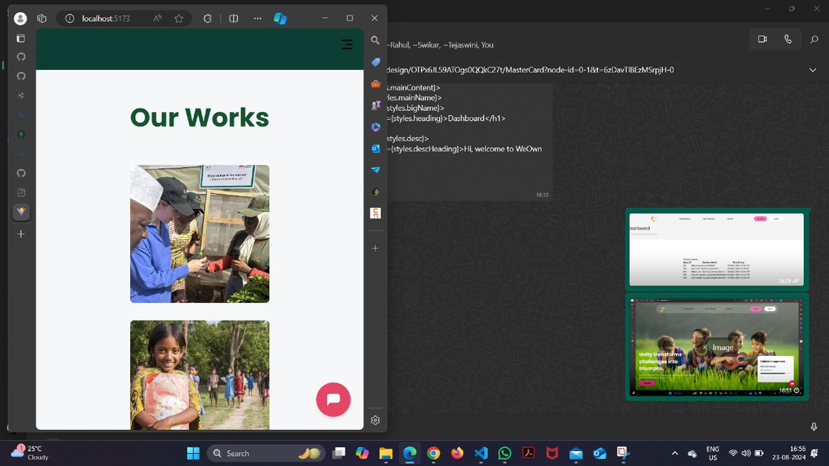
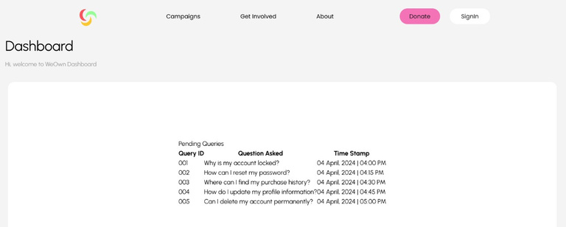
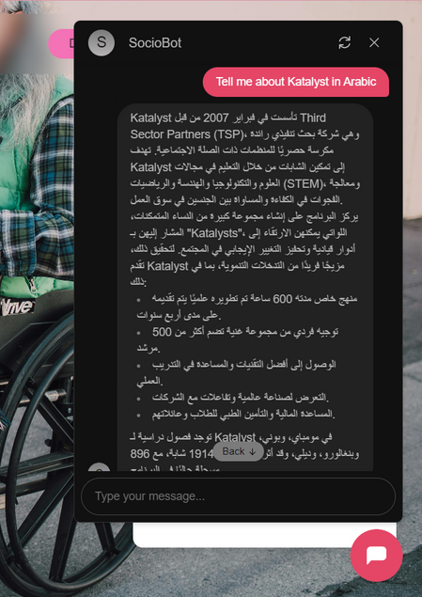
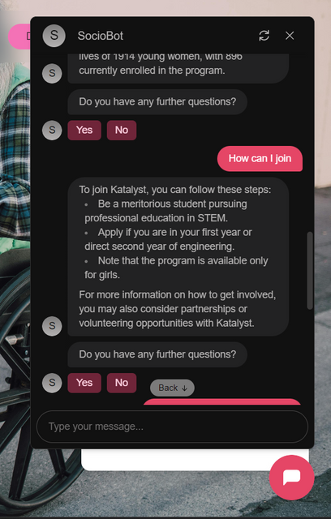
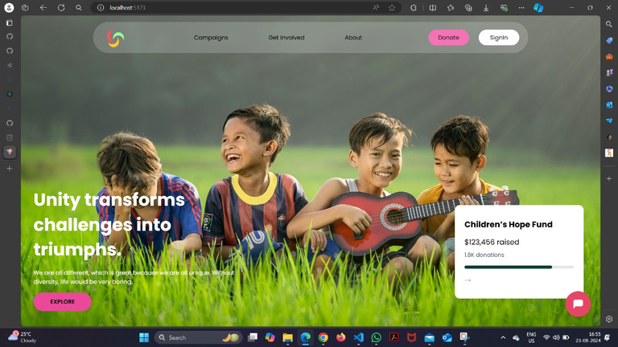

Slide 6

TECHSTACK
Frontend
Backend
ChatBot
REACT
TAILWIND CSS
FIGMA
NODE.JS
EXPRESS.JS
MONGODB
BOTPRESS

Slide 7
FUTURE SCOPE
Priority-Based Ticketing: Implement a system to prioritize and manage tickets based on urgency and importance.
Messaging App Integration: Expand capabilities to integrate with popular messaging platforms like WhatsApp and Slack.
Voice Command Support: Develop functionality to understand and process voice commands for hands-free interaction.
Image Recognition: Incorporate image recognition to analyze and respond to visual content shared by users.

Slide 8
Q&A

